Slide 1
Developing a growth mindset
Session 1: Defining ‘growth mindset’, its benefits and the role of effort

Slide 2
Session objectives
Introduce the concept of ‘growth mindset’
Dispel any myths around growth mindset
Explore the benefits of growth mindset
Explore the role of effort
Notes:
 Share the session objectives with participants and introduce the learning logs.
Explain that the learning logs can be used to record notes and reflections throughout the session.

Slide 3
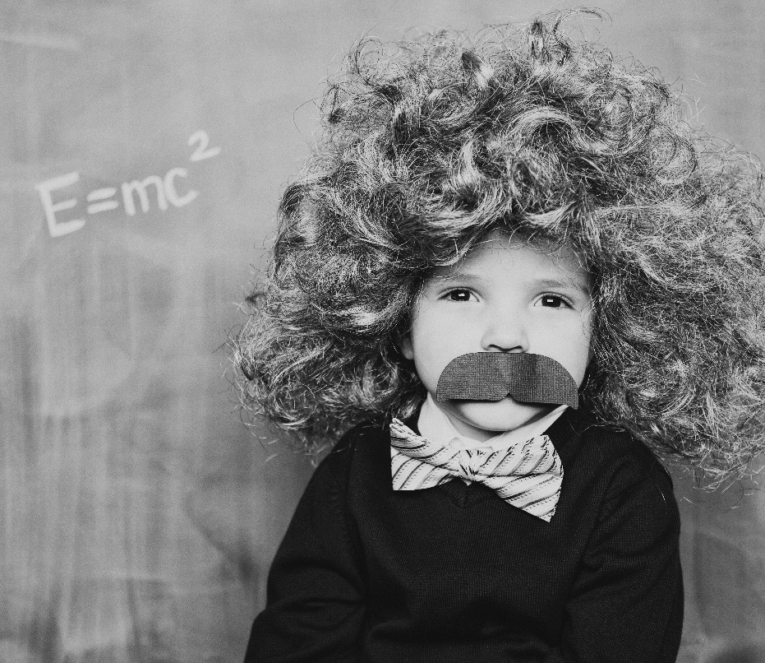
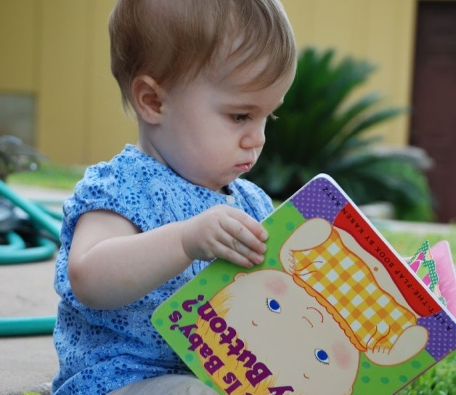
Intelligence/ability …
Source: iStock, Andrew Rich
Source: Z Read
Are you born with it …
or
… can you develop it?
Notes:
 The work on growth mindset, by researchers such as Carol Dweck, revolves around one simple question or belief. That is: “Are you born smart, or can you become smart?”
 Ask participants to discuss what they believe in pairs and decide on a percentage split in terms of nature versus nurture.

Slide 4
Success is a combination of:
Talent
Mindset
+
Notes:
 What Alfred Binet (and people with a growth mindset) believe is that being successful is a combination of two things:
1. Talent: some people seem to have natural ability. In school this may look like high IQ or good memory. This is what you are born with
2. Mindset: ask participants to come up with three words or terms that come to mind when you say “someone with a ‘good mindset’” (for example, good attitude, hard working, positive, etc.)
Some people ignore the role of mindset in success and, as a result, limit ambition and aspirations. Some people take it too far and ignore the role of talent in success, and this can lead to false hope.
All research tells us that both talent and mindset play a significant role. However, mindset is particularly malleable.

Slide 5
Mindset: talent matrix
Underachiever
Champion
Ordinary
Overachiever
Mindset
Notes:
 This matrix shows the relationship between talent and mindset:
Ordinary = low levels of talent with a poor mindset. The harsh reality is that if pupils do not have much natural talent and have a poor attitude, their results will be, at best, average
Underachiever = high levels of talent with a poor mindset. If pupils have lots of potential but don’t apply themselves they will underachieve and their talent will be wasted
Overachiever = low levels of talent with a good mindset. If pupils are not naturally talented but put lots of effort in, they are likely to achieve beyond expectations
Champion = high levels of talent with a good mindset
Growth mindset is great for getting people from the left-hand side into the right-hand side of the matrix.
 Note that there may be some debate over the labels used (for example, ‘ordinary’). This is healthy and to be expected as it can encourage discussion. It is also worth noting that people’s mindsets may vary from subject to subject, so this is a very fluid diagram.

Slide 6
Growth mindset: what it isn’t
Anyone can do anything
That ability doesn’t matter
Anti-competition
Making people feel better about failing
Simply telling pupils to ‘try harder’
A silver bullet
A quick fix
Notes:
 Explain that there are some common myths around what it means to have a growth mindset. This slide dispels some of those myths.

Slide 7
Growth mindset in seven
words or less
That intelligence is not set in stone
The belief that I can improve
Knowing that my talent can be developed
The knowledge that I can be better
Notes:
 This slide provides some definitions of growth mindset, using no more than seven words.
 Ask participants to compare these definitions to the ones they wrote in their learning logs at the start of the session. Are there any noteworthy similarities or differences? Participants may wish to adapt their original definition based on the last two slides.

Slide 8
What are the benefits?
If someone believes they can improve, what behaviours could this lead to?
Notes:
 Ask participants to discuss some of the benefits of the belief that you can improve. Allow time for feedback as a whole group.
 If participants struggle to offer ideas, move to the next slide, which provides some examples.

Slide 9
Growth mindset: benefits
Seek out better feedback (Mueller and Dweck, 1998)
Stretch themselves (Mueller and Dweck, 1998)
Want to persist for longer (Mueller and Dweck, 1998)
Cope better with transitions (Blackwell et al., 2007)
Higher levels of grit (Hinton and Hendrick, 2015)
Better grades (Dweck, 2008 and Paunesku et al., 2015)
Less likely to drop out of school (Paunesku et al., 2015)
Reduced stress and aggression (Yeager and Dweck, 2012)
Notes:
 This slide outlines some of the benefits of having a growth mindset, which have been evidenced in research.
 Ask participants to discuss:
Which benefits they would like to see realised in school
Any findings that are particularly interesting or unexpected
 Provide an opportunity for participants to jot down any stand-out points on their learning logs.
 The full list of references can be found at the end of this presentation.

Slide 10
The role of effort
Fixed mindset
Growth mindset
Pointless

Vital
Effort
Counter indicator
Worth it
Risky
Pride
Notes:
 This slide is animated. Start by showing the ‘Growth mindset’ box only.
Ask participants to discuss how individuals might perceive the role of effort if they have a ‘growth mindset’ – that is, they believe that you can improve and develop ability.
 Compare participants’ answers to the answers on the slide:
1. Vital: individuals with a growth mindset know that talent alone will not help them succeed and that effort is an integral part of success
2. Worth it: the achievements and associated consequences are seen to outweigh the effort required
3. Pride: pupils with a growth mindset take pride in how hard they work and see it as a badge of honour

Slide 11
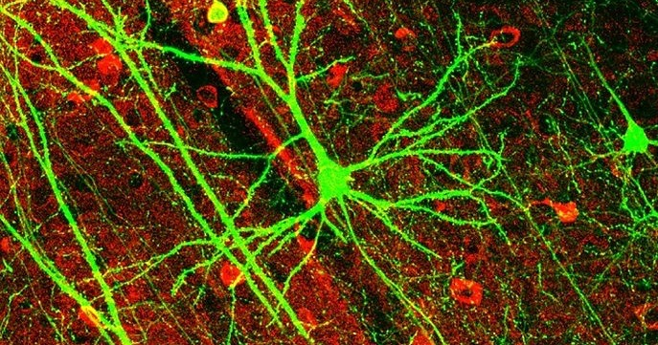
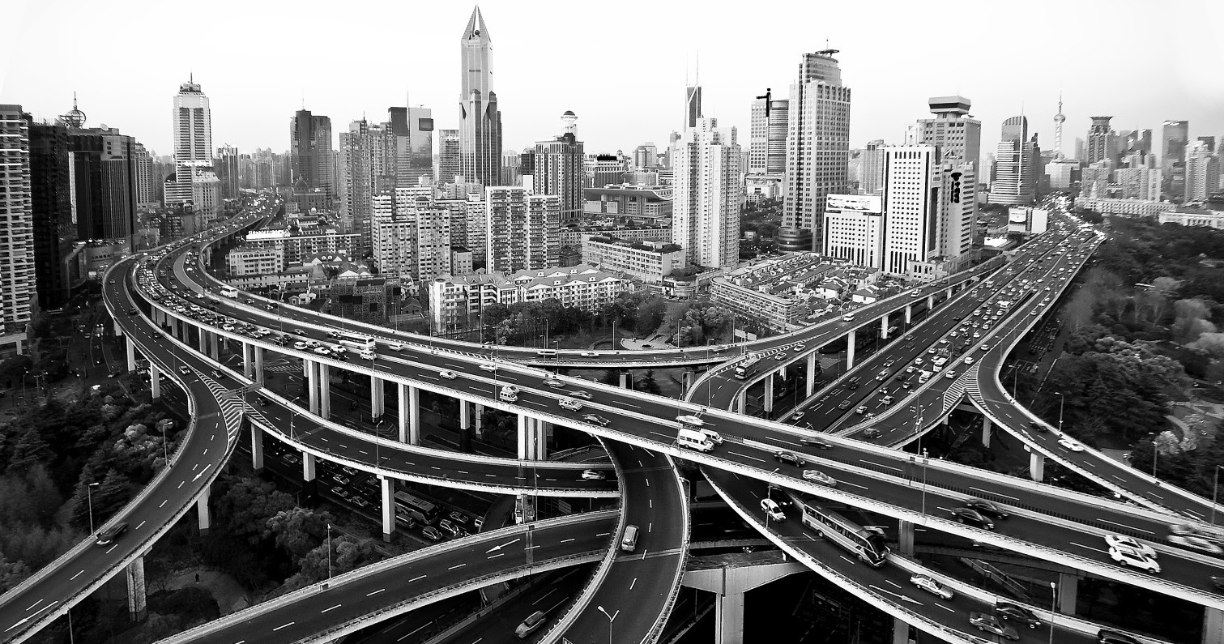
The brain and effort
Source: Allen Lee, Huang, Feng, Sanes, Brown, So, and Nedivi
Notes:
 This slide is animated. It starts by showing a picture of neurons followed by a ‘super highway’.
 Explain that we can help pupils to develop a positive attitude towards effort by talking to them about the brain.
Science shows that the brain can grow and develop. The brain itself is not static.
Neurons make connections. Learning new things, practising and trying hard can strengthen the connections, allowing messages to travel more effectively and efficiently.
The first time you try something, the connections are narrow and fragile. But with each effort and learning, they connect and strengthen – eventually growing from garden paths to super highways. The scientific term for this is ‘neuroplasticity’.
There is a video explanation of this for facilitators, which you may like to watch video 1.3 in advance of the session: https://cpd.thekeysupport.com/node/290/289

Slide 12
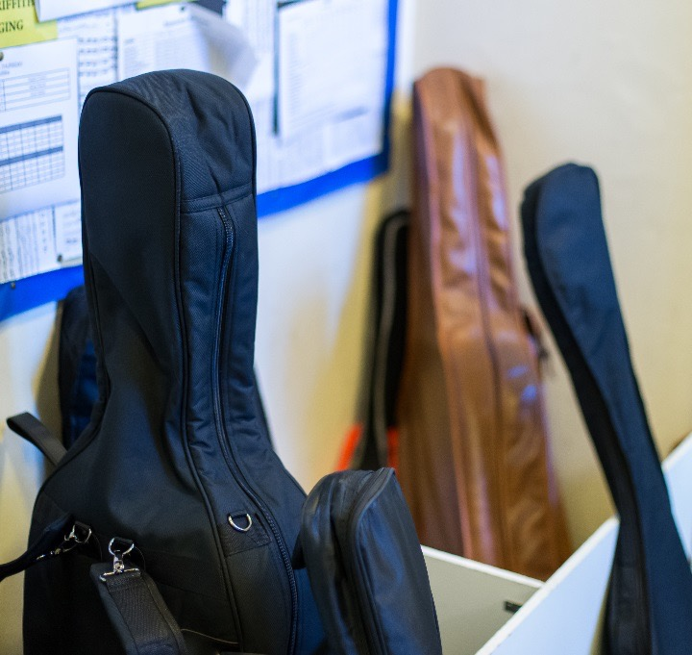
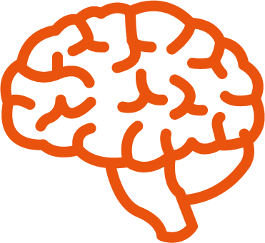
Source: Fujioka, 2006
The brain and effort
Auditory cortex
Children aged 4 to 6
Music lessons for one year
Notes:
 There are studies which demonstrate neuroplasticity (the brain’s ability to change and develop).
For example, in a study of 4 to 6 year-olds, half of the participants were given violin lessons and the other half had no music lessons. One year later, tests showed that those children who had received music lessons showed different brain development and improved memory. Evidence found that, in response to violin tones, trained children showed larger and earlier responses in the auditory cortex of their brain.
If you would like to read more, a summary of the study can be found here: https://www.sciencedaily.com/releases/2006/09/060920093024.htm
Image source: https://pixabay.com/en/brain-human-anatomy-body-155656/

Slide 13
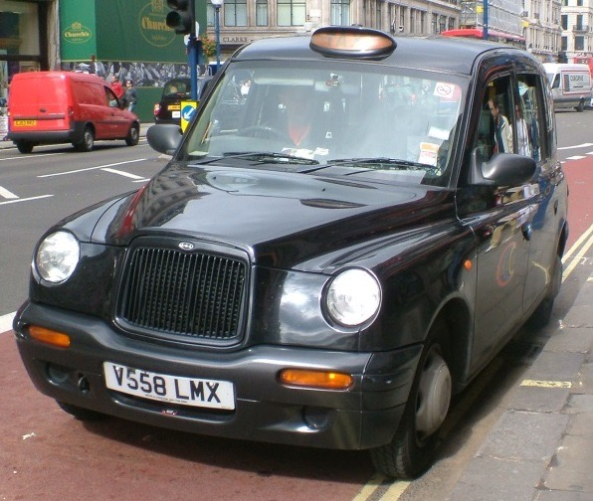
Source: Maguire et al., 2000
The brain and effort
Image source: Carey Evans
320 routes
25,000 streets
20,000 landmarks
Hippocampus
Notes:
 Another study looked at taxi drivers. To be a taxi driver you need to pass a test called The Knowledge. It is very hard and takes most people around four years of studying to pass it.
This study compared the brains of taxi drivers before and after they completed The Knowledge. In taxi drivers who had completed The Knowledge, the researchers found a significant increase in the size of the posterior hippocampus – the area of the brain associated with memory and spatial navigation.
 Allow a few minutes for participants to discuss these studies and the key messages that can be taken from them.
Image source: https://pixabay.com/en/brain-human-anatomy-body-155656/

Slide 14
Praise
Purposeful praise:
CLEVER
Effort over
natural ability
Process over
outcome
Notes:
 Praise can be used as an effective tool to support growth mindset, as long as it is directed carefully and has a purpose.
Avoid using labels, especially “You are so clever”. Although praising intelligence can increase confidence, once given a label, those with a fixed mindset will be keen to protect it and will not want to risk failing and losing that title. As such, they are less likely to try new things, which we will discuss later.
Praise the behaviours and habits that will lead to future success. Therefore, praise effort over natural ability and outcome – for example, “You did well, you must have tried hard” instead of “You did well, you must be so clever”.

Slide 15
Praise
© The Key CPD Toolkit | InnerDrive
Notes:
 Praise can be used as an effective tool to support growth mindset, as long as it is directed carefully and has a purpose.
Avoid using labels, especially “You are so clever”. Although praising intelligence can increase confidence, once given a label, those with a fixed mindset will be keen to protect it and will not want to risk failing and losing that title. As such, they are less likely to try new things, which we will discuss later.
Praise the behaviours and habits that will lead to future success. Therefore, praise effort over natural ability and outcome – for example, “You did well, you must have tried hard” instead of “You did well, you must be so clever”.

Slide 16
The Pygmalion effect
Notes:
 Ask participants to read and discuss handout 1.1 about the ‘Pygmalion effect’.
The handout outlines research around teacher expectation and pupil performance. The main finding is that if you have high expectations, pupils will try to rise up to them; this is called the ‘Pygmalion effect’.
On the other hand, if expectations are low, pupils will be unlikely to fulfil their full potential; this is called the ‘Golem effect’.

Slide 17
The Pygmalion effect
Notes:
 Ask participants to read and discuss handout 1.1 about the ‘Pygmalion effect’.
The handout outlines research around teacher expectation and pupil performance. The main finding is that if you have high expectations, pupils will try to rise up to them; this is called the ‘Pygmalion effect’.
On the other hand, if expectations are low, pupils will be unlikely to fulfil their full potential; this is called the ‘Golem effect’.

Slide 18
The Pygmalion effect
Notes:
Ask participants to discuss the handout.
What findings stand out? How can the findings be applied in this school?
Encourage an extended discussion around the last question: What does a classroom with ‘high expectations’ look like?
Provide paper and pens so that participants can record their ideas. They might also use their learning logs for the last question.

Slide 19
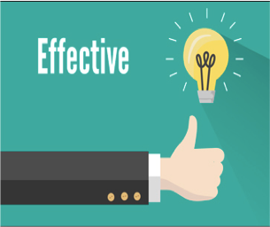
Part 2
Notes:
 Praise can be used as an effective tool to support growth mindset, as long as it is directed carefully and has a purpose.
Avoid using labels, especially “You are so clever”. Although praising intelligence can increase confidence, once given a label, those with a fixed mindset will be keen to protect it and will not want to risk failing and losing that title. As such, they are less likely to try new things, which we will discuss later.
Praise the behaviours and habits that will lead to future success. Therefore, praise effort over natural ability and outcome – for example, “You did well, you must have tried hard” instead of “You did well, you must be so clever”.

Slide 20
What do we want for our children?
We want our children to be inspired by the world around them and be taught exciting and engaging lessons.
We want our children to make great progress and be proud of the things they have learnt and the work that they have done.
Notes:
 Praise can be used as an effective tool to support growth mindset, as long as it is directed carefully and has a purpose.
Avoid using labels, especially “You are so clever”. Although praising intelligence can increase confidence, once given a label, those with a fixed mindset will be keen to protect it and will not want to risk failing and losing that title. As such, they are less likely to try new things, which we will discuss later.
Praise the behaviours and habits that will lead to future success. Therefore, praise effort over natural ability and outcome – for example, “You did well, you must have tried hard” instead of “You did well, you must be so clever”.

Slide 21
Reasons for changing the way that we mark and give feedback.
We noticed that the books from 2016-17 had lots of marking in them that hadn’t been responded to - either the children didn’t know what they needed to do or they hadn’t been given the time to complete it to the best of their ability. The children were making progress but we felt that it could be improved upon.
I visited other schools from outside the borough who had implemented effective feedback and could immediately see the great progress evident in books all across the school. The children that I spoke to were really enthusiastic about the benefits of being given verbal feedback instead of traditional marking.
Notes:
 Praise can be used as an effective tool to support growth mindset, as long as it is directed carefully and has a purpose.
Avoid using labels, especially “You are so clever”. Although praising intelligence can increase confidence, once given a label, those with a fixed mindset will be keen to protect it and will not want to risk failing and losing that title. As such, they are less likely to try new things, which we will discuss later.
Praise the behaviours and habits that will lead to future success. Therefore, praise effort over natural ability and outcome – for example, “You did well, you must have tried hard” instead of “You did well, you must be so clever”.

Slide 22
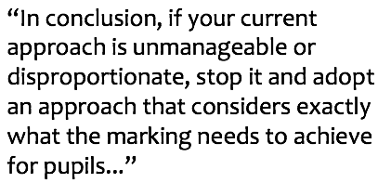
Teaching happens in the lesson, not at home!
Notes:
 Praise can be used as an effective tool to support growth mindset, as long as it is directed carefully and has a purpose.
Avoid using labels, especially “You are so clever”. Although praising intelligence can increase confidence, once given a label, those with a fixed mindset will be keen to protect it and will not want to risk failing and losing that title. As such, they are less likely to try new things, which we will discuss later.
Praise the behaviours and habits that will lead to future success. Therefore, praise effort over natural ability and outcome – for example, “You did well, you must have tried hard” instead of “You did well, you must be so clever”.

Slide 23
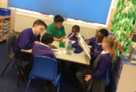
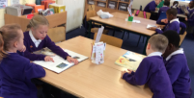
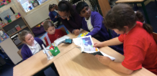
So we took it right back to the basics and focused on the children
Children make better progress when they are given feedback whilst they are doing their activities. This way they can make immediate changes and edits. This feedback includes praise for the effort they are putting in as well as some pointers for improvement.
Notes:
 Praise can be used as an effective tool to support growth mindset, as long as it is directed carefully and has a purpose.
Avoid using labels, especially “You are so clever”. Although praising intelligence can increase confidence, once given a label, those with a fixed mindset will be keen to protect it and will not want to risk failing and losing that title. As such, they are less likely to try new things, which we will discuss later.
Praise the behaviours and habits that will lead to future success. Therefore, praise effort over natural ability and outcome – for example, “You did well, you must have tried hard” instead of “You did well, you must be so clever”.

Slide 24
What you might see in the books
Every time a child responds to feedback, edits and improves their work or self reflects, they use a green pen.
Notes:
 Praise can be used as an effective tool to support growth mindset, as long as it is directed carefully and has a purpose.
Avoid using labels, especially “You are so clever”. Although praising intelligence can increase confidence, once given a label, those with a fixed mindset will be keen to protect it and will not want to risk failing and losing that title. As such, they are less likely to try new things, which we will discuss later.
Praise the behaviours and habits that will lead to future success. Therefore, praise effort over natural ability and outcome – for example, “You did well, you must have tried hard” instead of “You did well, you must be so clever”.

Slide 25
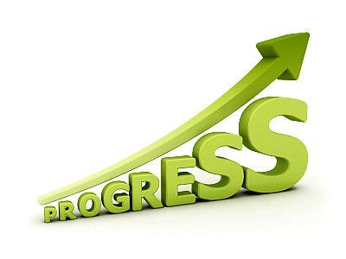
Changes along the way…
Early in the Autumn term last year we realised that we would still need to mark in depth the end of unit writing pieces.
We also had to do a lot of work with the children to teach them to give high quality feedback to a partner.
Very quickly we could see that the children were making better progress and were able to confidently talk about their learning and what they needed to do next to improve their work.
Notes:
 Praise can be used as an effective tool to support growth mindset, as long as it is directed carefully and has a purpose.
Avoid using labels, especially “You are so clever”. Although praising intelligence can increase confidence, once given a label, those with a fixed mindset will be keen to protect it and will not want to risk failing and losing that title. As such, they are less likely to try new things, which we will discuss later.
Praise the behaviours and habits that will lead to future success. Therefore, praise effort over natural ability and outcome – for example, “You did well, you must have tried hard” instead of “You did well, you must be so clever”.

Slide 26
What we want:
Notes:
 Praise can be used as an effective tool to support growth mindset, as long as it is directed carefully and has a purpose.
Avoid using labels, especially “You are so clever”. Although praising intelligence can increase confidence, once given a label, those with a fixed mindset will be keen to protect it and will not want to risk failing and losing that title. As such, they are less likely to try new things, which we will discuss later.
Praise the behaviours and habits that will lead to future success. Therefore, praise effort over natural ability and outcome – for example, “You did well, you must have tried hard” instead of “You did well, you must be so clever”.

Slide 27
It’s all about progress
Notes:
 Praise can be used as an effective tool to support growth mindset, as long as it is directed carefully and has a purpose.
Avoid using labels, especially “You are so clever”. Although praising intelligence can increase confidence, once given a label, those with a fixed mindset will be keen to protect it and will not want to risk failing and losing that title. As such, they are less likely to try new things, which we will discuss later.
Praise the behaviours and habits that will lead to future success. Therefore, praise effort over natural ability and outcome – for example, “You did well, you must have tried hard” instead of “You did well, you must be so clever”.

Slide 28
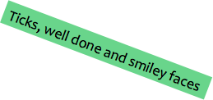
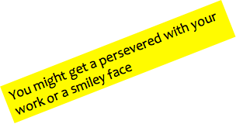
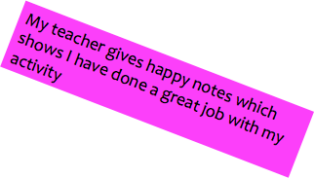
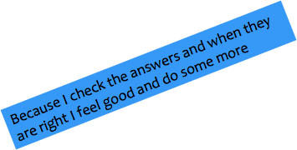
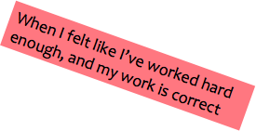
How do you know if you have done well in your learning?
Notes:
 Praise can be used as an effective tool to support growth mindset, as long as it is directed carefully and has a purpose.
Avoid using labels, especially “You are so clever”. Although praising intelligence can increase confidence, once given a label, those with a fixed mindset will be keen to protect it and will not want to risk failing and losing that title. As such, they are less likely to try new things, which we will discuss later.
Praise the behaviours and habits that will lead to future success. Therefore, praise effort over natural ability and outcome – for example, “You did well, you must have tried hard” instead of “You did well, you must be so clever”.

Slide 29
How do you feel about being given verbal feedback?
Notes:
 Praise can be used as an effective tool to support growth mindset, as long as it is directed carefully and has a purpose.
Avoid using labels, especially “You are so clever”. Although praising intelligence can increase confidence, once given a label, those with a fixed mindset will be keen to protect it and will not want to risk failing and losing that title. As such, they are less likely to try new things, which we will discuss later.
Praise the behaviours and habits that will lead to future success. Therefore, praise effort over natural ability and outcome – for example, “You did well, you must have tried hard” instead of “You did well, you must be so clever”.

Slide 30
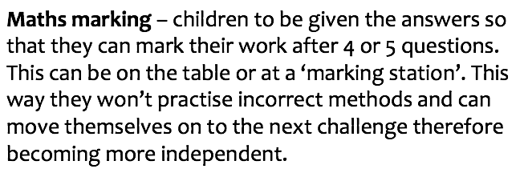
Maths:
Notes:
 Praise can be used as an effective tool to support growth mindset, as long as it is directed carefully and has a purpose.
Avoid using labels, especially “You are so clever”. Although praising intelligence can increase confidence, once given a label, those with a fixed mindset will be keen to protect it and will not want to risk failing and losing that title. As such, they are less likely to try new things, which we will discuss later.
Praise the behaviours and habits that will lead to future success. Therefore, praise effort over natural ability and outcome – for example, “You did well, you must have tried hard” instead of “You did well, you must be so clever”.

Slide 31
How does marking your work help you to move your learning on?
Notes:
 Praise can be used as an effective tool to support growth mindset, as long as it is directed carefully and has a purpose.
Avoid using labels, especially “You are so clever”. Although praising intelligence can increase confidence, once given a label, those with a fixed mindset will be keen to protect it and will not want to risk failing and losing that title. As such, they are less likely to try new things, which we will discuss later.
Praise the behaviours and habits that will lead to future success. Therefore, praise effort over natural ability and outcome – for example, “You did well, you must have tried hard” instead of “You did well, you must be so clever”.

Slide 32
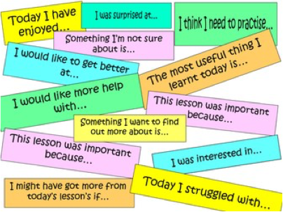
Self Reflections
Notes:
 Praise can be used as an effective tool to support growth mindset, as long as it is directed carefully and has a purpose.
Avoid using labels, especially “You are so clever”. Although praising intelligence can increase confidence, once given a label, those with a fixed mindset will be keen to protect it and will not want to risk failing and losing that title. As such, they are less likely to try new things, which we will discuss later.
Praise the behaviours and habits that will lead to future success. Therefore, praise effort over natural ability and outcome – for example, “You did well, you must have tried hard” instead of “You did well, you must be so clever”.

Slide 33
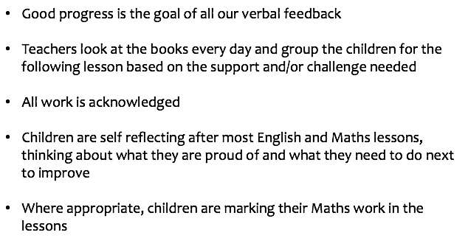
Key things to note:
Notes:
 Praise can be used as an effective tool to support growth mindset, as long as it is directed carefully and has a purpose.
Avoid using labels, especially “You are so clever”. Although praising intelligence can increase confidence, once given a label, those with a fixed mindset will be keen to protect it and will not want to risk failing and losing that title. As such, they are less likely to try new things, which we will discuss later.
Praise the behaviours and habits that will lead to future success. Therefore, praise effort over natural ability and outcome – for example, “You did well, you must have tried hard” instead of “You did well, you must be so clever”.

