Slide 1
Year 1 & 2 Parent Subtraction Workshop
Thursday 26th January 2017

Slide 2
Objectives
Year 2
I can solve problems with subtraction, including those involving numbers, quantities and measure.
I can answer simple subtraction questions in my head as well as by writing them down.
I can use subtraction facts to 20 to work out similar facts to 100.
I can subtract a two-digit number and a one-digit number in my head.
I can subtract a multiple of ten to a given two-digit number in my head.
I can subtract 2 two-digit numbers in my head.
I can subtract 3 one-digit numbers in my head.
I can show that subtraction cannot be done in any order.
I can show that subtraction is the opposite of addition and use this to check my work.
I can solve missing number problems using subtraction.
Year 1
I can read, write and understand number statements using - and =.
I can use number bonds and matching subtraction facts up to 20 e.g. 7+3=10 so 10-7=3.
I can use number bonds and matching subtraction facts up to 10.
I can subtract one digit and two digit numbers to 20.
I can answer problems that use subtraction, including missing number problems, using objects and pictures.

Slide 3

What words can you think of that are related to subtraction?

Slide 4
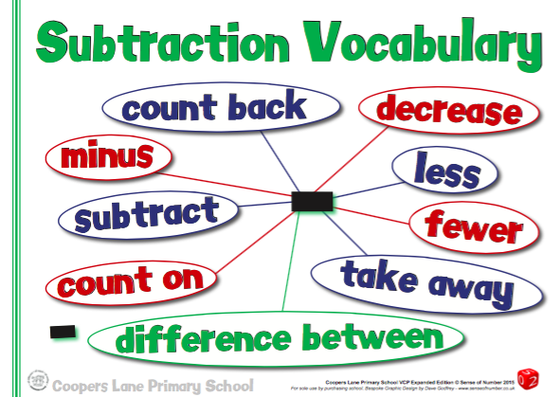
Vocabulary

Slide 5
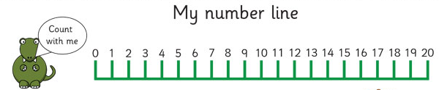
Apparatus
Number Lines

Slide 6
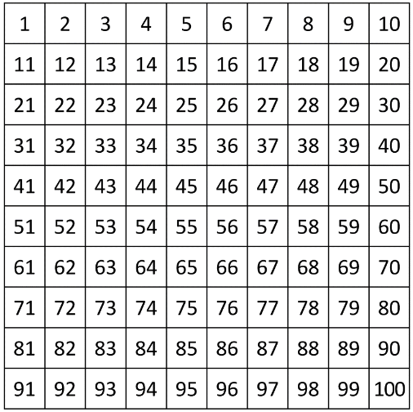
Apparatus
100 Square

Slide 7
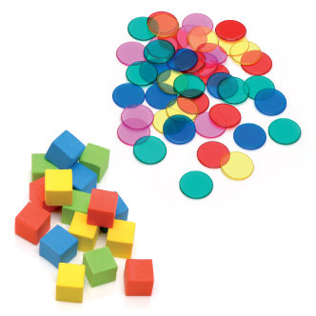
Apparatus
Counters and Cubes

Slide 8
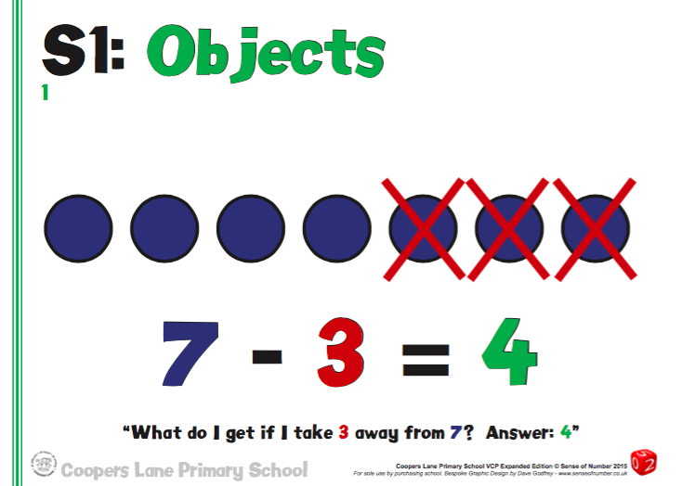
Year 1

Slide 9
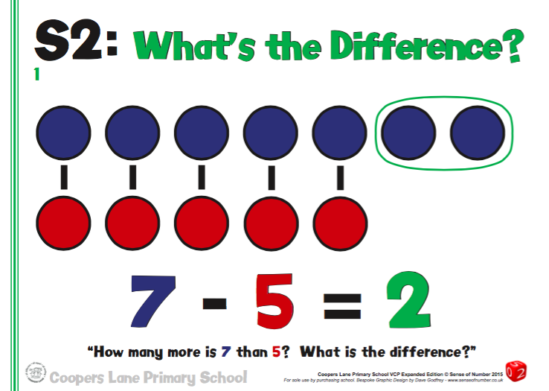
Subtraction

Slide 10
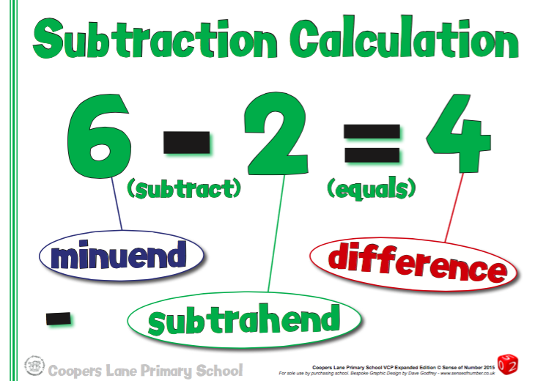
Year 1

Slide 11
Method 1
Counting Back

Slide 12
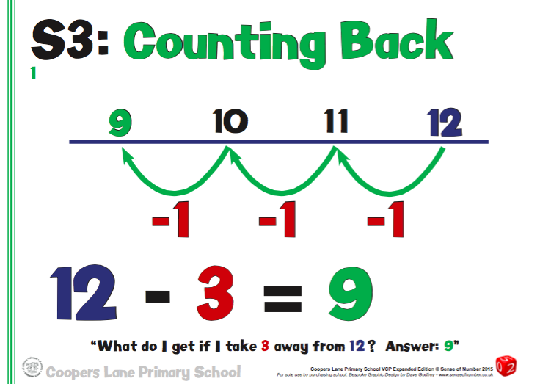
Year 1

Slide 13
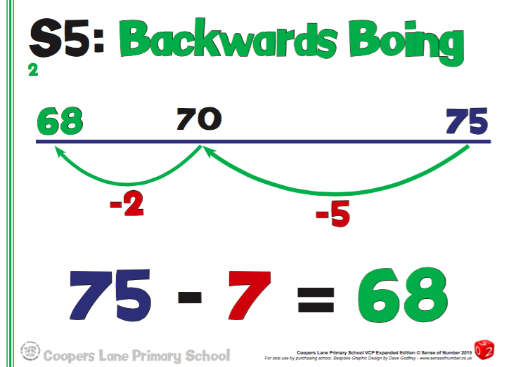
Year 2

Slide 14
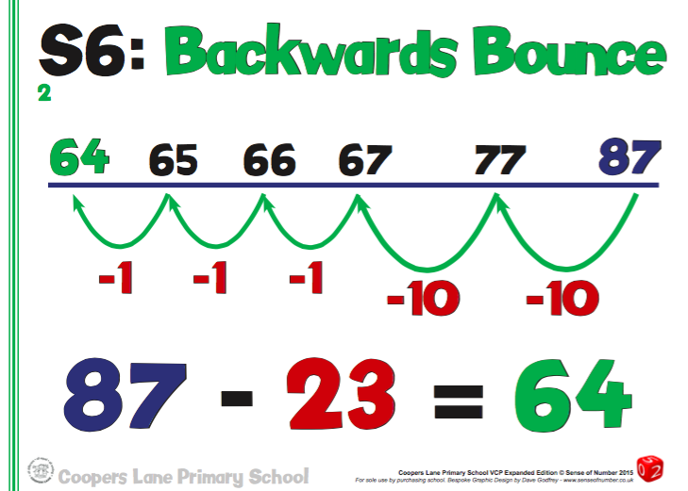
Year 2

Slide 15
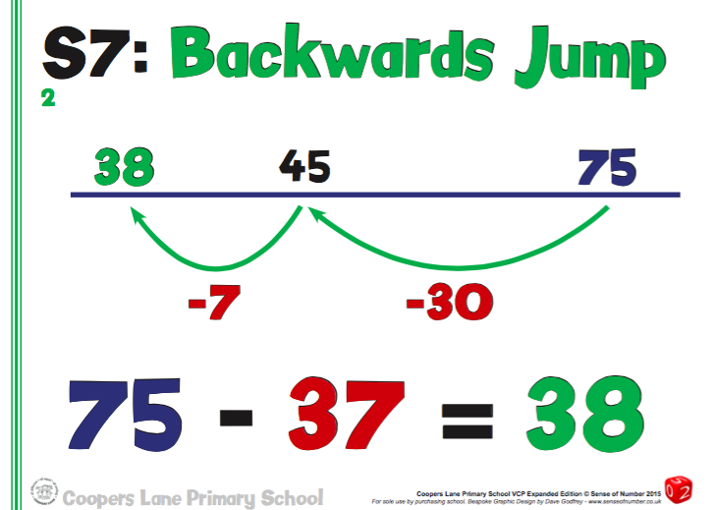
Year 2

Slide 16
Method 2
Counting On

Slide 17
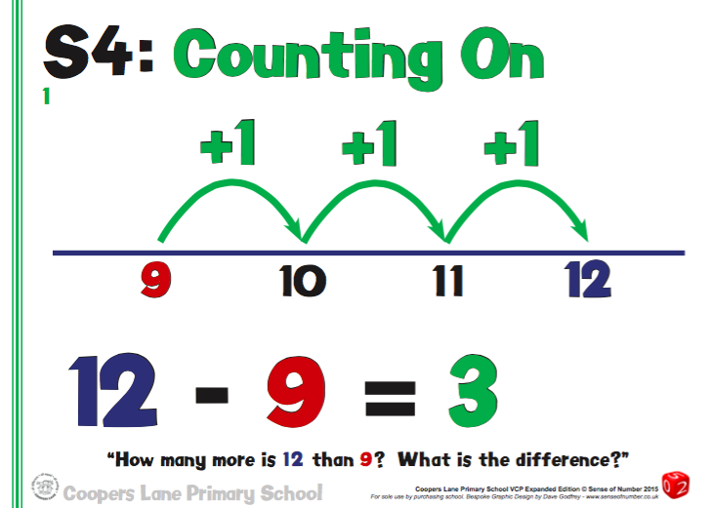
Year 1

Slide 18
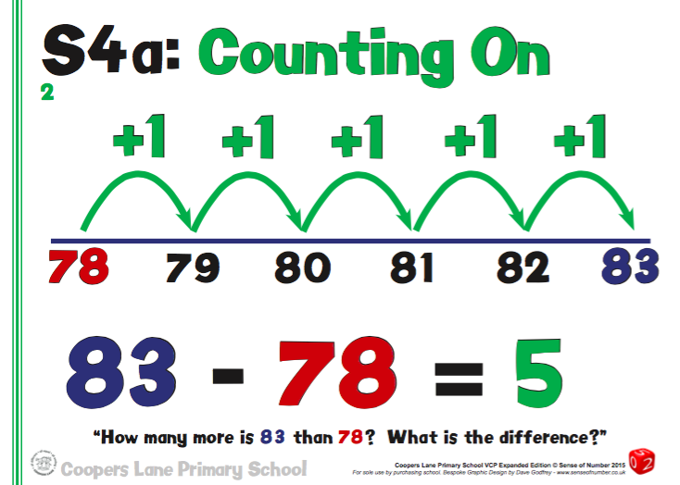
Year 2

Slide 19
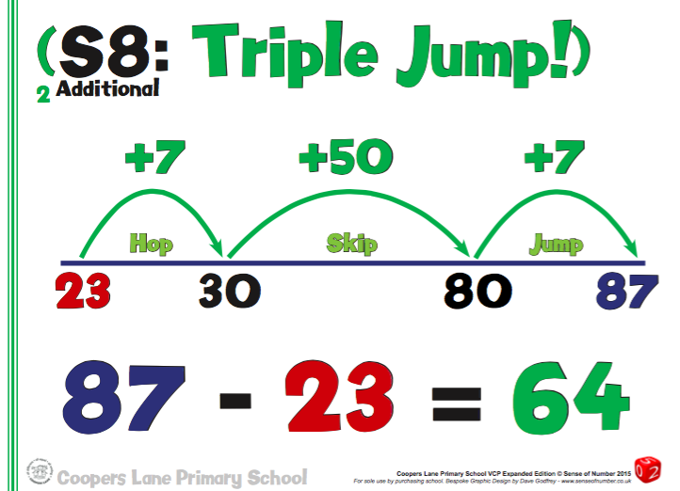
Year 2

Slide 20
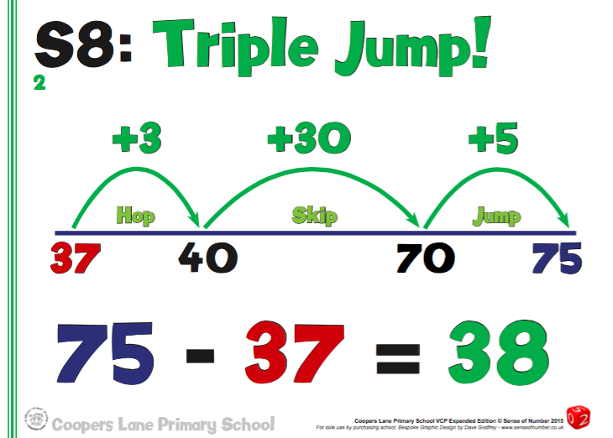
Year 2

Slide 21
Method 3
10s Jump, 1s Jump

Slide 22
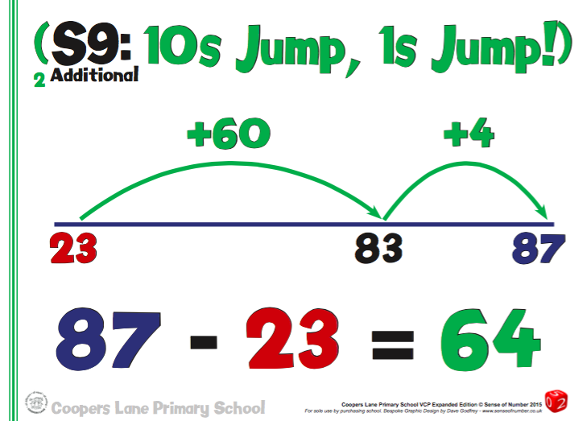
Year 2

Slide 23
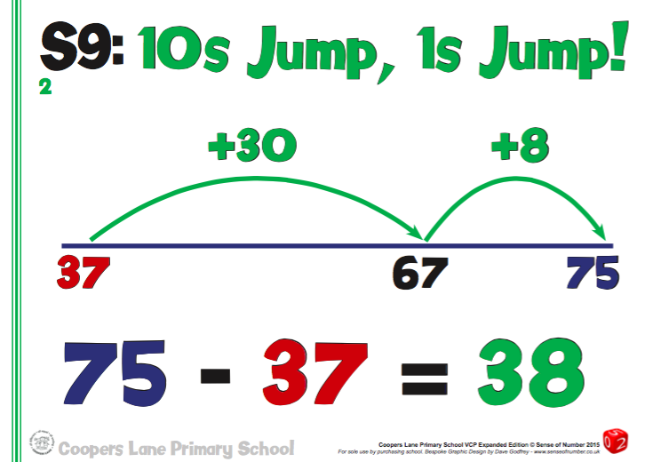
Year 2

Slide 24
Method 4
Expanded Column

Slide 25
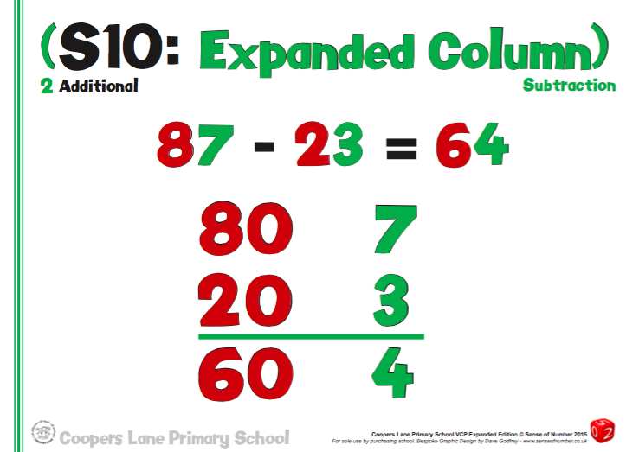
Year 2

Slide 26
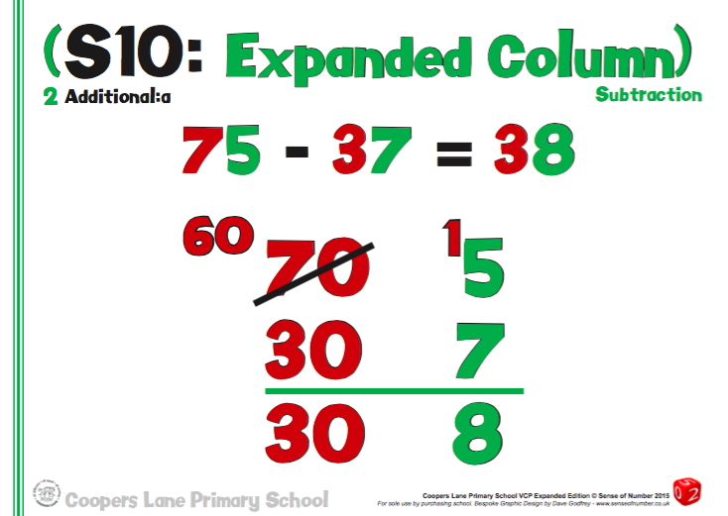
Year 2

Slide 27
Method 5
Column Subtraction

Slide 28
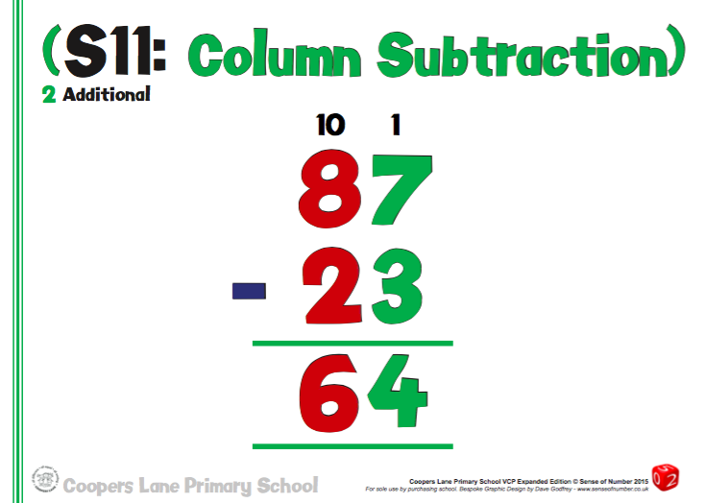
Year 2

Slide 29
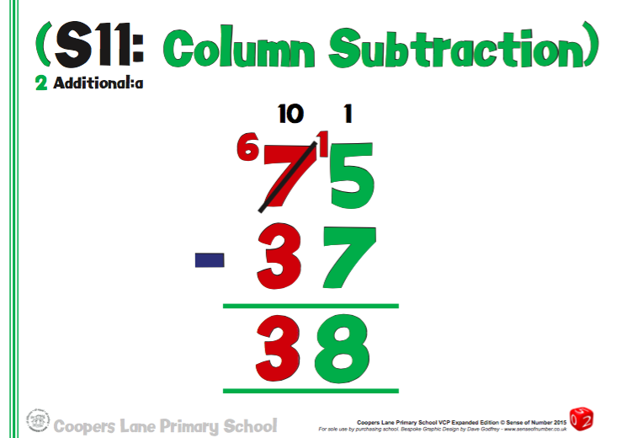
Year 2

Slide 30

Useful Apps

Slide 31
Any Questions?

