Slide 1
Year 1 & 2 Parent Multiplication & Division Workshop
Thursday 2nd January 2017

Slide 2
Objectives – Multiplication & Division
Year 1
I can answer multiplication and division questions using objects, pictures and other equipment
Year 2
I can remember and use multiplication and division facts for the 2, 5 and 10 times table.
I can recognise odd and even numbers.
I can answer multiplication and division problems within the times tables using x, ÷ and =.
I can show that multiplying 2 numbers can be done in any order but division cannot.
I can answer questions involving multiplication and division using repeated addition.
I can rewrite repeated addition questions as multiplication questions.

Slide 3

What words can you think of that are related to multiplication?

Slide 4
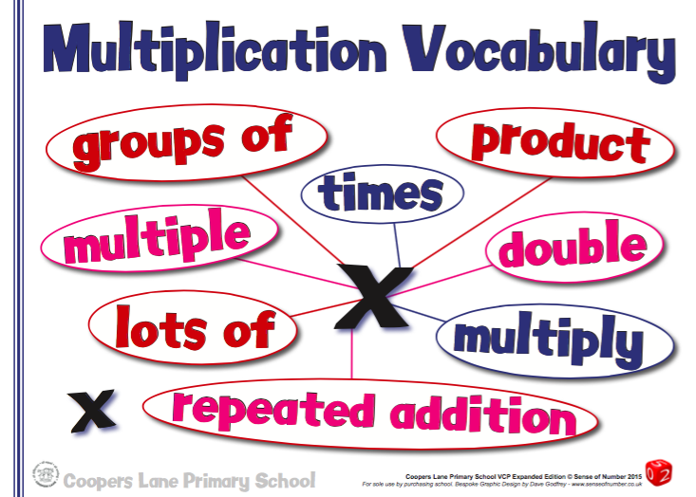
Vocabulary

Slide 5
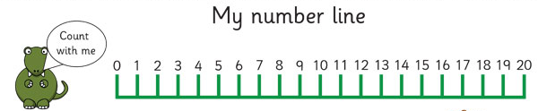
Apparatus
Number Lines

Slide 6
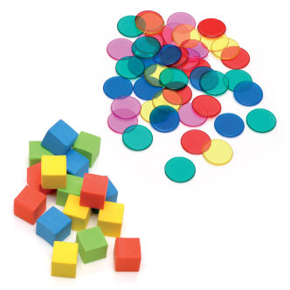
Apparatus
Counters and Cubes

Slide 7
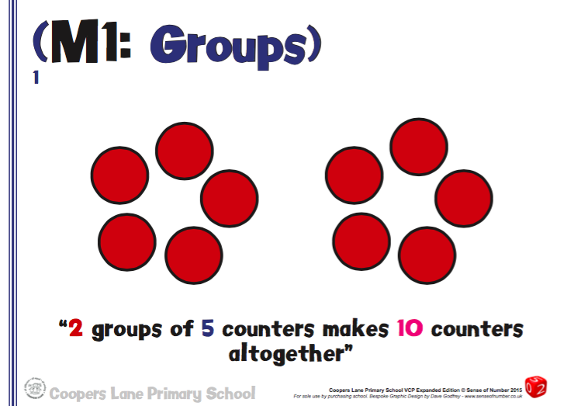
Year 1 - Groups

Slide 8
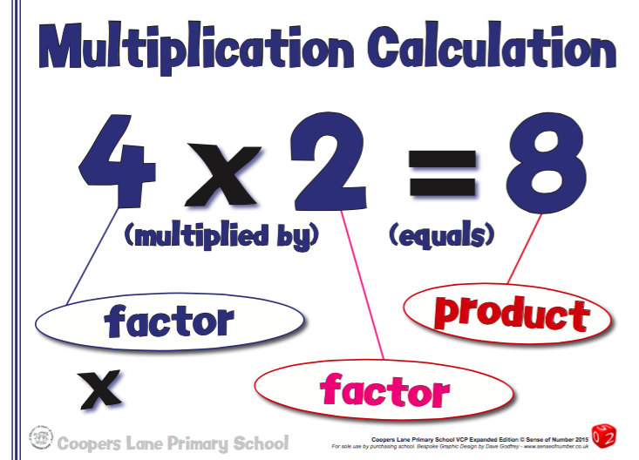
Calculation

Slide 9
Method 1
Repeated Addition

Slide 10
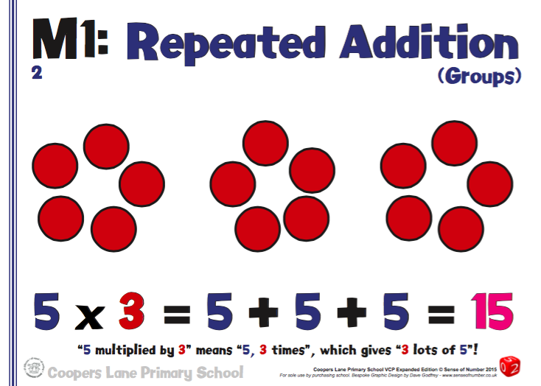
Year 1

Slide 11
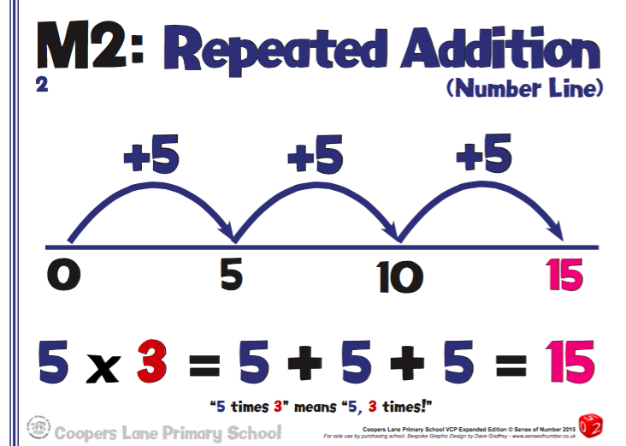
Year 2

Slide 12
Method 2
Arrays

Slide 13
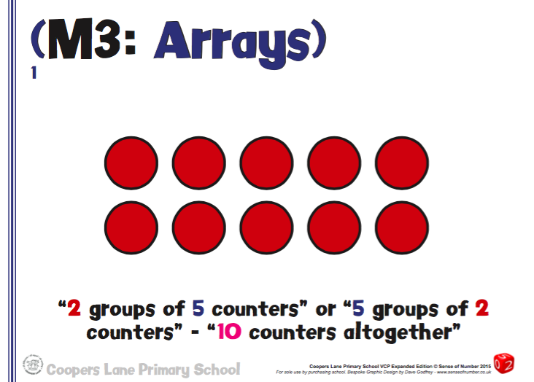
Year 1

Slide 14
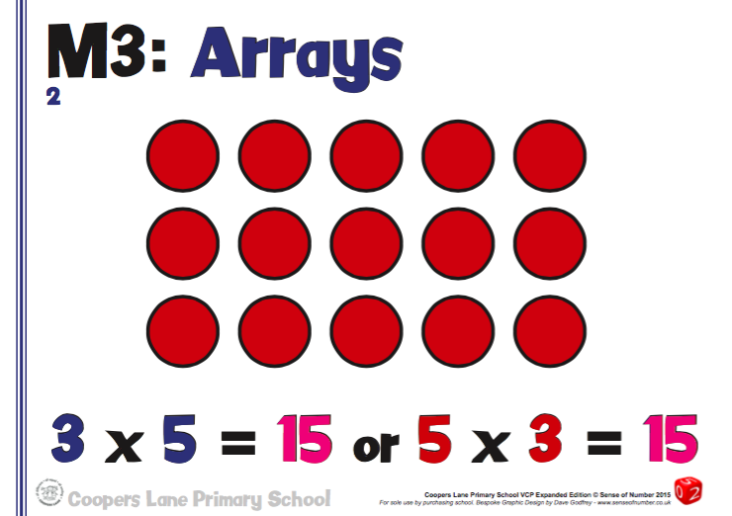
Year 2

Slide 15
Times Tables

Slide 16
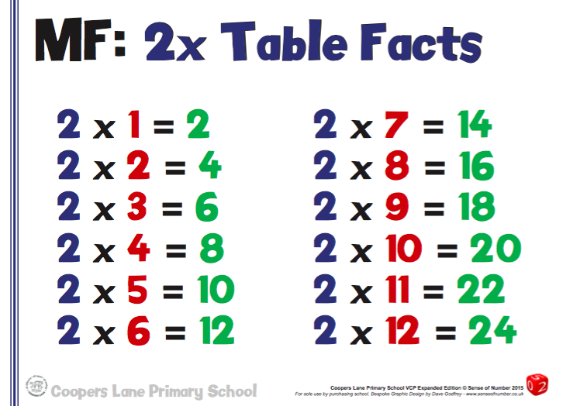
Year 2

Slide 17
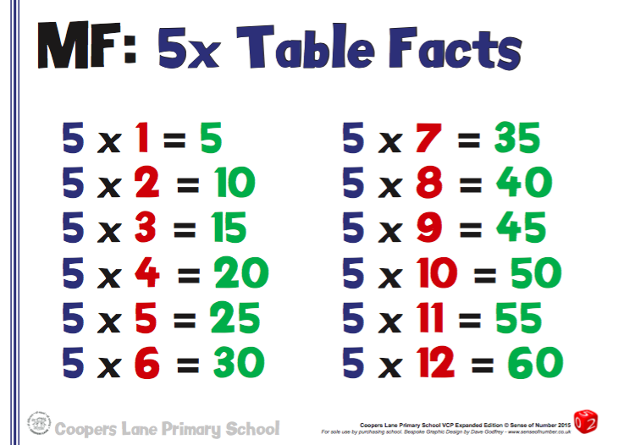
Year 2

Slide 18
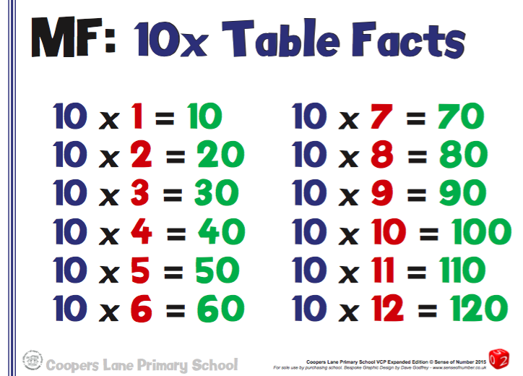
Year 2

Slide 19
Division

Slide 20

What words can you think of that are related to division?

Slide 21
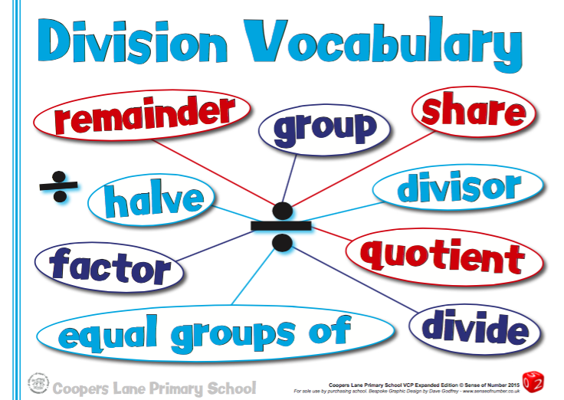
Vocabulary

Slide 22
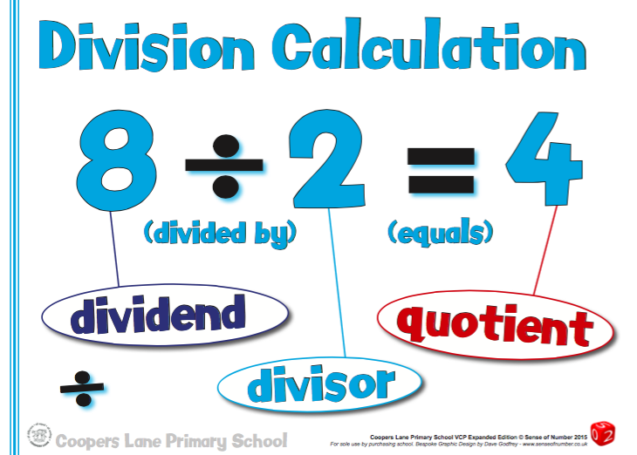
Calculation

Slide 23
Method 1
Sharing

Slide 24
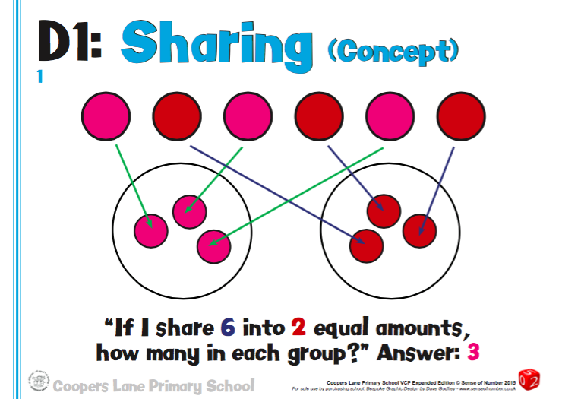
Year 1

Slide 25
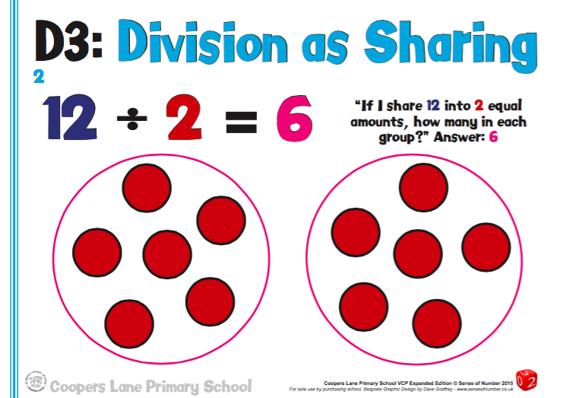
Year 2

Slide 26
Method 2
Grouping

Slide 27
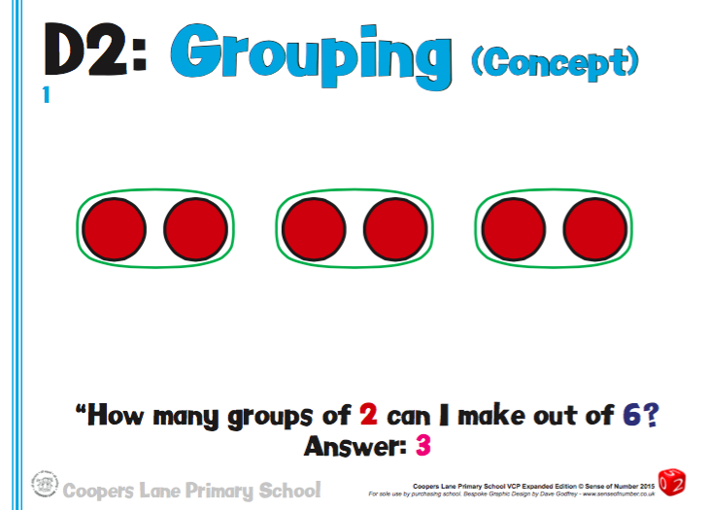
Year 1

Slide 28
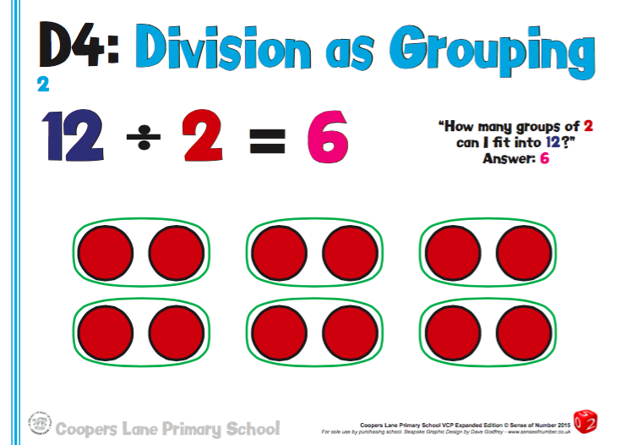
Year 2

Slide 29
Method 3
Grouping on a Number Line

Slide 30
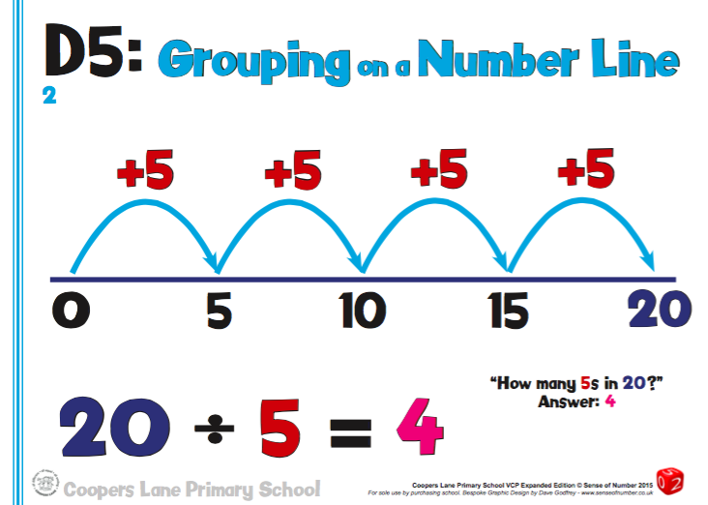
Year 2

Slide 31
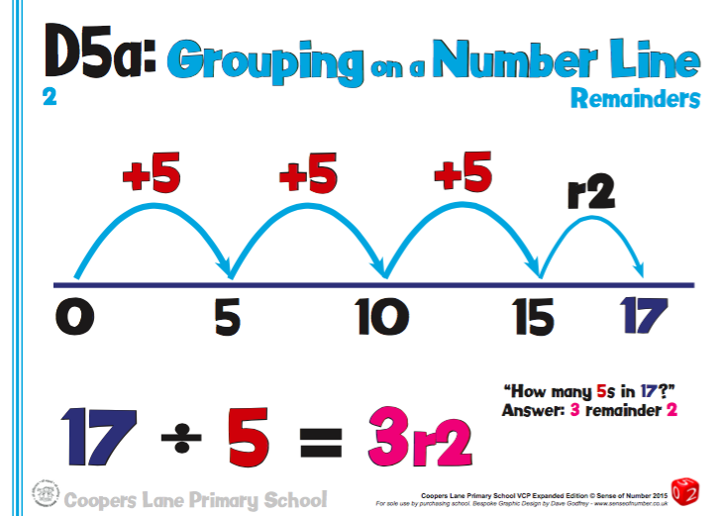
Year 2

Slide 32

Useful Apps

Slide 33
Any Questions?

